Slide 1
Python Functions

Slide 2

Function
A function is a block of code which only runs when it is called.
You can pass data, known as parameters, into a function.
A function can return data as a result.
Creating a Function
In Python a function is defined using the def keyword:

Slide 3
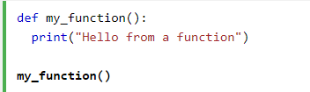
Calling a Function
To call a function, use the function name followed by parenthesis:

Slide 4
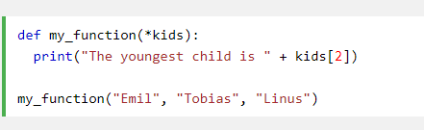
Arbitrary Arguments, *args
If you do not know how many arguments that will be passed into your function, add a * before the parameter name in the function definition.
This way the function will receive a tuple of arguments, and can access the items accordingly:

Slide 5
List

Slide 6
Python Lists
Lists are used to store multiple items in a single variable.
Lists are one of 4 built-in data types in Python used to store collections of data, the other 3 are Tuple, Set, and Dictionary, all with different qualities and usage.
In Python programming, a list is created by placing all the items (elements) inside square brackets [], separated by commas.
It can have any number of items and they may be of different types (integer, float, string etc.).
# empty list
my_list = []
# list of integers
my_list = [1, 2, 3]
# list with mixed data types
my_list = [1, "Hello", 3.4]
A list can also have another list as an item. This is called a nested list.
# nested list
my_list = ["mouse", [8, 4, 6], ['a']]

Slide 7
How to access elements from a list?
There are various ways in which we can access the elements of a list.
List Index
We can use the index operator [] to access an item in a list. In Python, indices start at 0. So, a list having 5 elements will have an index from 0 to 4.
Trying to access indexes other than these will raise an IndexError. The index must be an integer.
Negative indexing
Python allows negative indexing for its sequences. The index of -1 refers to the last item, -2 to the second last item and so on.

Slide 8
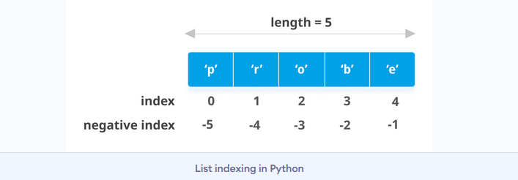

Slide 9
How to slice lists in Python?
We can access a range of items in a list by using the slicing operator :(colon).
# List slicing in Python
my_list = ['p','r','o','g','r','a','m','i','z']
# elements 3rd to 5th
print(my_list[2:5])
# elements beginning to 4th
print(my_list[:-5])
# elements 6th to end
print(my_list[5:])
# elements beginning to end
print(my_list[:])

Slide 10
How to change or add elements to a list?
Lists are mutable, meaning their elements can be changed unlike string or tuple.
We can use the assignment operator (=) to change an item or a range of items.
# Correcting mistake values in a list
odd = [2, 4, 6, 8]
# change the 1st item
odd[0] = 1
print(odd)
# change 2nd to 4th items
odd[1:4] = [3, 5, 7]
print(odd)
We can add one item to a list using the append() method or add several items using extend() method.
# Appending and Extending lists in Python
odd = [1, 3, 5]
odd.append(7)
print(odd)
odd.extend([9, 11, 13])
print(odd)

Slide 11
We can also use + operator to combine two lists. This is also called concatenation.
The * operator repeats a list for the given number of times.
# Concatenating and repeating lists
odd = [1, 3, 5]
print(odd + [9, 7, 5])
print(["re"] * 3)
Furthermore, we can insert one item at a desired location by using the method insert() or insert multiple items by squeezing it into an empty slice of a list.
# Demonstration of list insert() method
odd = [1, 9]
odd.insert(1,3)
print(odd)
odd[2:2] = [5, 7]
print(odd)

Slide 12
How to delete or remove elements from a list?
We can delete one or more items from a list using the keyword del. It can even delete the list entirely.
# Deleting list items my_list = ['p', 'r', 'o', 'b', 'l', 'e', 'm']
# delete one item
del my_list[2]
print(my_list)
# delete multiple items
del my_list[1:5]
print(my_list)
# delete entire list
del my_list
# Error: List not defined
print(my_list)

Slide 13
We can use remove() method to remove the given item or pop() method to remove an item at the given index.
The pop() method removes and returns the last item if the index is not provided. This helps us implement lists as stacks (first in, last out data structure).
We can also use the clear() method to empty a list.
my_list = ['p','r','o','b','l','e','m']
my_list.remove('p')
# Output: ['r', 'o', 'b', 'l', 'e', 'm']
print(my_list)
# Output: 'o'
print(my_list.pop(1))
# Output: ['r', 'b', 'l', 'e', 'm']
print(my_list)
# Output: 'm' print(my_list.pop())
# Output: ['r', 'b', 'l', 'e']
print(my_list) my_list.clear(
) # Output: [] print(my_list)

Slide 14
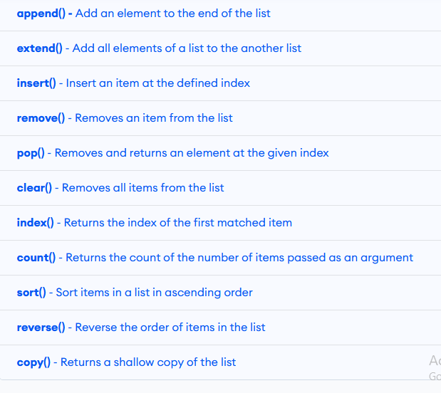
Python List Methods

Slide 15
# Python list methods
my_list = [3, 8, 1, 6, 0, 8, 4]
# Output: 1
print(my_list.index(8))
# Output: 2
print(my_list.count(8))
my_list.sort()
# Output: [0, 1, 3, 4, 6, 8, 8]
print(my_list) my_list.reverse()
# Output: [8, 8, 6, 4, 3, 1, 0]
print(my_list)

Slide 16
Other List Operations in Python
We can test if an item exists in a list or not, using the keyword in.
my_list = ['p', 'r', 'o', 'b', 'l', 'e', 'm']
#Output: True
print('p' in my_list)
#Output: False
print('a' in my_list)
#Output: True
print('c' not in my_list)

Slide 17
Using a for loop we can iterate through each item in a list.
for fruit in ['apple','banana','mango']:
print("I like",fruit)

Slide 18
Dictionaries

Slide 19
Dictionary
Dictionaries are used to store data values in key:value pairs.
A dictionary is a collection which is unordered, changeable and does not allow duplicates.
Dictionaries are written with curly brackets, and have keys and values:
thisdict = { "brand": "Ford", "model": "Mustang", "year": 1964 } print(thisdict)

Slide 20
Dictionary items are unordered, changeable, and does not allow duplicates.
Dictionary items are presented in key : value pairs, and can be referred to by using the key name.

Slide 21
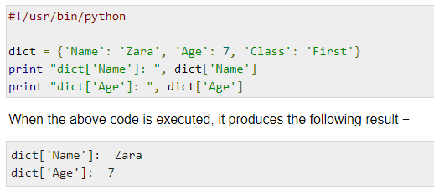
Accessing Values in Dictionary

Slide 22
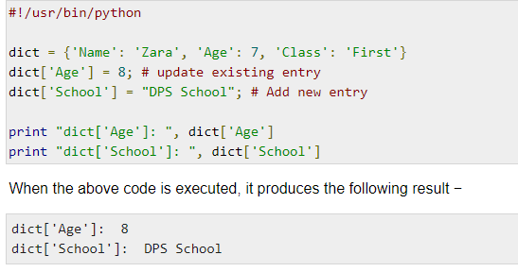
Updating Dictionary

Slide 23
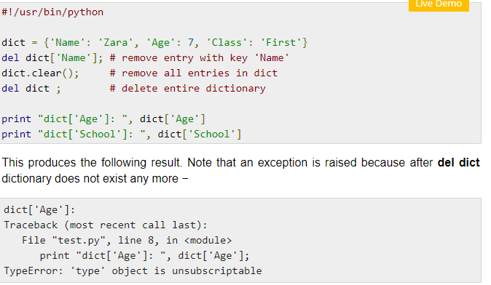
Delete Dictionary Elements

Slide 24
Properties of Dictionary Keys
Dictionary values have no restrictions. They can be any arbitrary Python object, either standard objects or user-defined objects. However, same is not true for the keys.
There are two important points to remember about dictionary keys −
(a) More than one entry per key not allowed. Which means no duplicate key is allowed. When duplicate keys encountered during assignment, the last assignment wins.
(b) Keys must be immutable. Which means you can use strings, numbers or tuples as dictionary keys but something like ['key'] is not allowed.

Slide 25
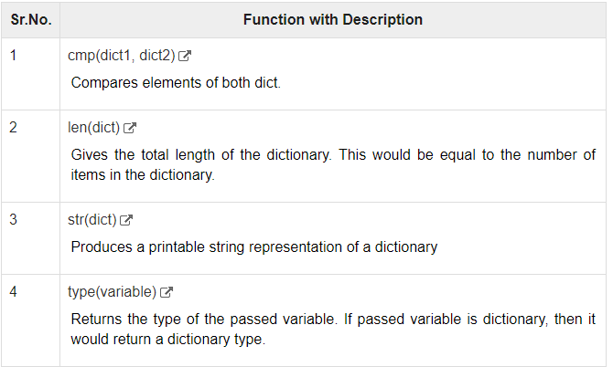
Built-in Dictionary Functions & Methods

Slide 26
